Slide 1







20250104
BLENDED RETIREMENT SYSTEM
20231120
CONTINUATION PAY
Eligibility:
Enrolled in Blended Retirement System (BRS)
8 years of service (but less than 12)
M-Day Soldiers, AGRs, Technicians, Enlisted, and Officers!
  Sign the BRS-CP request form before 12 years of service
  Includes 4-year service obligation from date of request
  Does not preclude eligible Soldiers from an extension bonus
Benefit:
BRS Continuation Pay is a one-time, mid-career bonus
  AGRs receive 2.5x monthly base pay
  M-Day Soldiers/Officers receive 2.5x monthly base pay
Examples:
M-Day Soldier
SSG/E6
8 years service
M-Day Officer
CPT/O3
10 years service
AGR Soldier
SFC/E7
10 years service
$10,630
$12,216
$19,304
Contact your unit Retention NCO today!

Slide 2
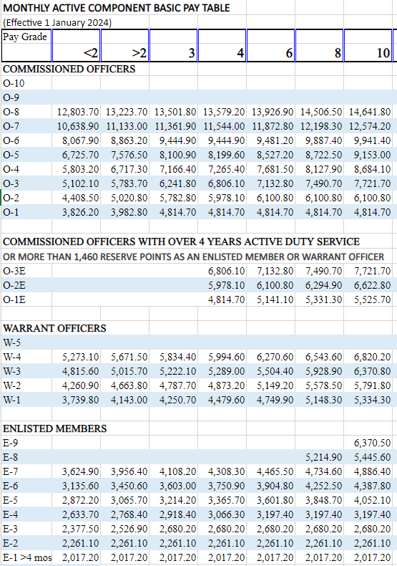
BLENDED RETIREMENT SYSTEM
Example
M-Day Soldier
SSG/E6
8 years service
$4,252.5 x 2.5 =
$10,630
Contact your unit Retention NCO today!

