Slide 1
20240109
BLENDED RETIREMENT SYSTEM
20231120
CONTINUATION PAY
Eligibility:
Enrolled in Blended Retirement System (BRS)
8 years of service (but less than 12)
M-Day Soldiers, AGRs, Technicians, Enlisted, and Officers!
Sign the BRS-CP request form before 12 years of service
Includes 4-year service obligation from date of request
Does not preclude eligible Soldiers from an extension bonus
Benefit:
BRS Continuation Pay is a one-time, mid-career bonus
AGRs receive 2.5x monthly base pay
M-Day Soldiers/Officers receive 4x monthly base pay
Examples:
M-Day Soldier
SSG/E6
8 years service
M-Day Officer
CPT/O3
10 years service
AGR Soldier
SFC/E7
10 years service
$17,010
$12,216
$30,886
Contact your unit Retention NCO today!

Slide 2
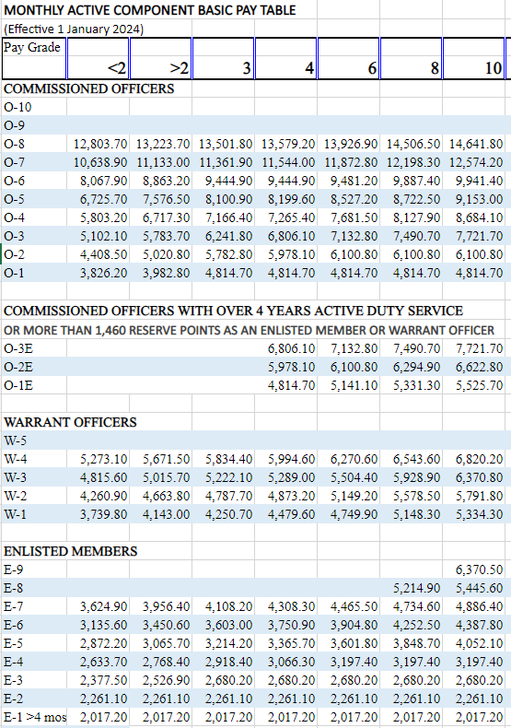
BLENDED RETIREMENT SYSTEM
Example
M-Day Soldier
SSG/E6
8 years service
$4,252.5 x 4 =
$17,010
Contact your unit Retention NCO today!

